Slide 1
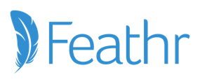
From Unreliable Magic to Good Marketing: A Community-First Framework for Growth
Presented by: Noah Barnett VP of Marketing

Slide 2
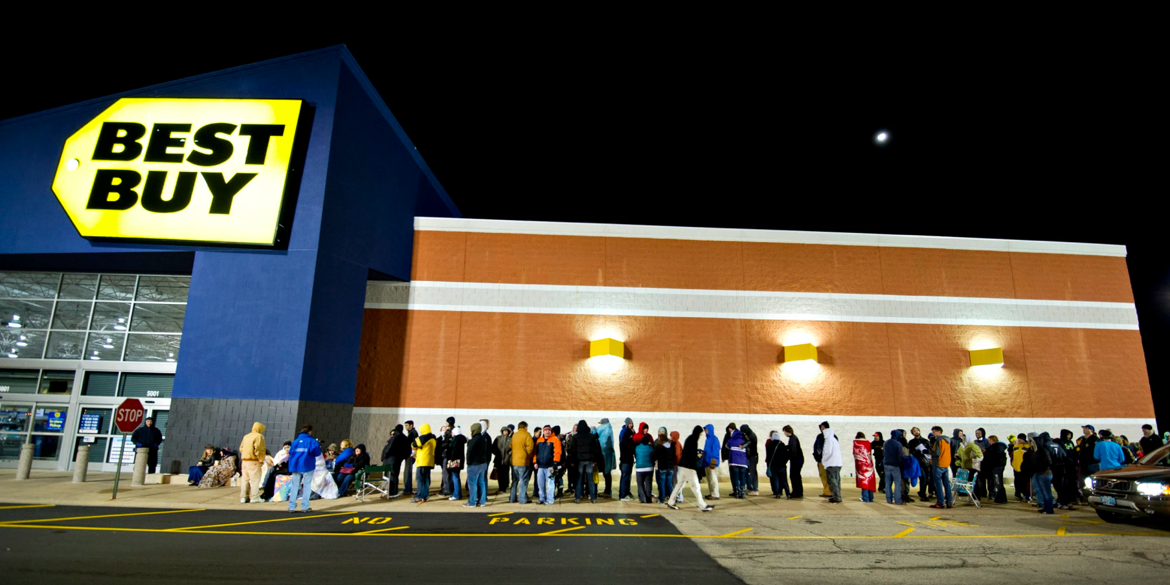
Notes:
… waiting in line for hours early in the dark hours of the morning.
Why? To be one of the first to get the latest video game or system, the latest book in your favorite series, a ludicrous deal on a 72’ TV or smart washer / dryer combo.
Is it magic? Nope. It’s marketing.

Slide 3
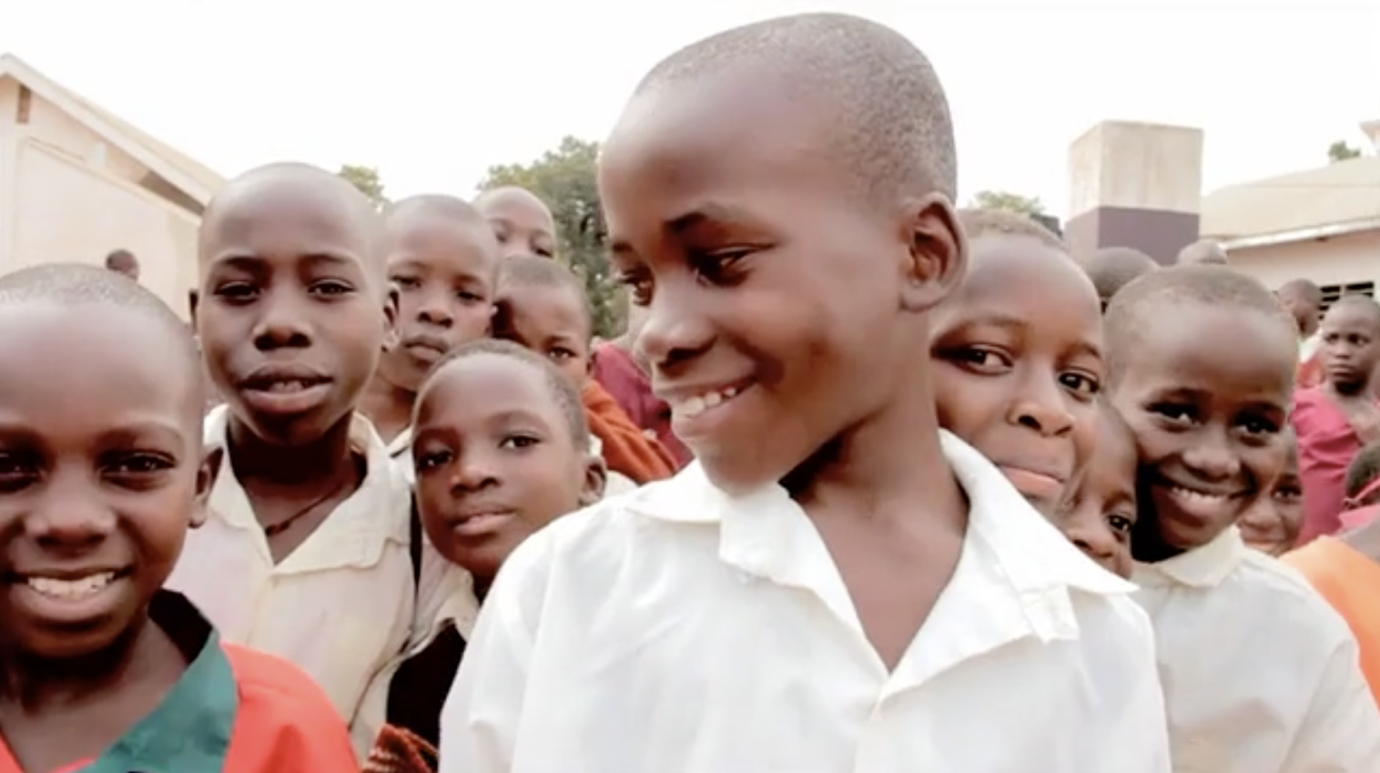
Notes:
Francis story

Slide 4
I N S I G H T
Most nonprofits rely
on magic ✨ not marketing.

Slide 5
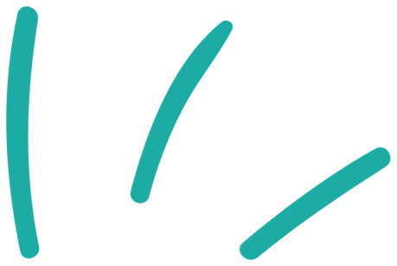
T R E N D
We’re operating on fumes

Slide 6
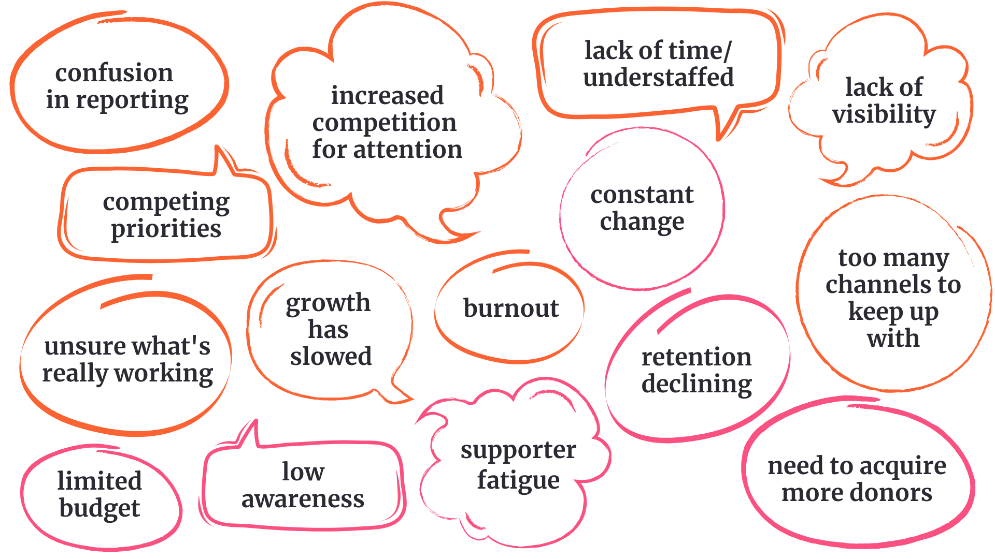
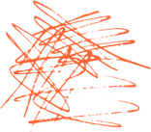
supporter fatigue
Notes:
I know this a very busy word wall - but at first glance, who would say Lack of Bandwidth is something they are struggling with right now, what about limited budget, not having clear reporting?

Slide 7
Nonprofits are facing 4 primary challenges they seek to grow impact …
CHANGE is now constant and it’s difficult to keep up
CONFUSION
in reporting and what efforts really work
COMPETING priorities; understaffed and under-resourced
COMPETITION for attention is fierce driving up costs

Slide 8
Typical marketing
Nothing
Everything
Ad Hoc
Good marketing
Community-first
Responsive
Omnichannel
Measurable
U N R E L I A B L E M A G I C

Slide 9
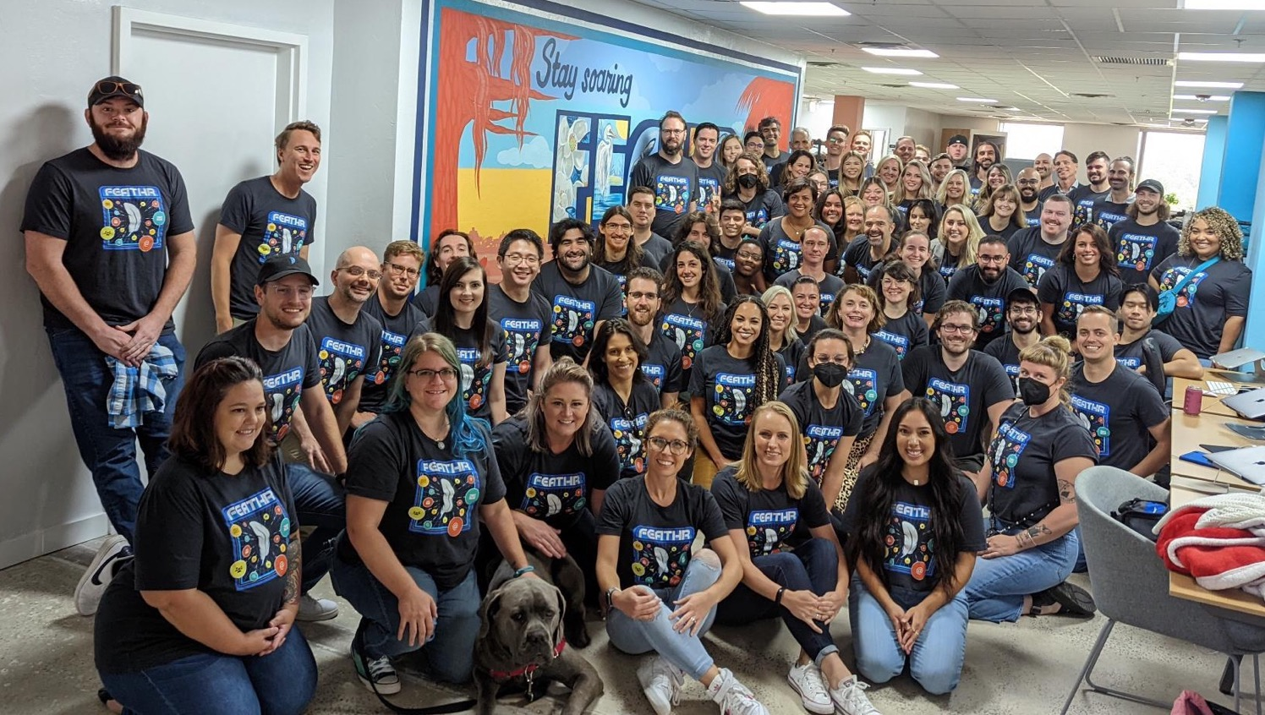

Slide 10
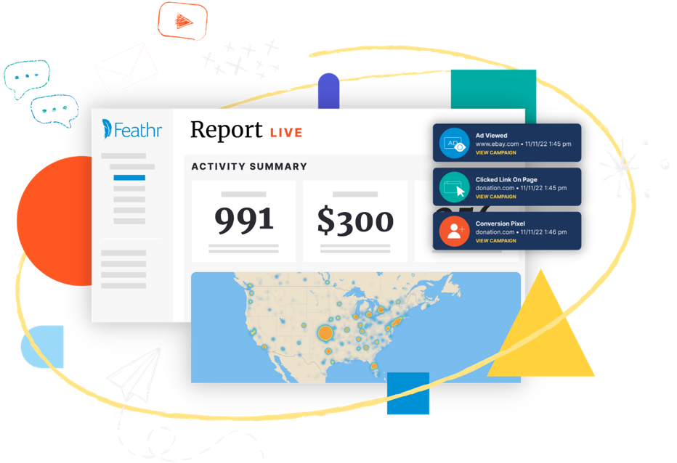
A D S | E M A I L | A N A L Y T I C S
Feathr helps your nonprofit run and report on integrated marketing campaigns that grow your community and unlock more impact.
Stop by the Feathr booth to see how!
Notes:
SAY: Feathr is the good marketing platform purpose-built to help you you know, grow, and engage your audiences across multiple channels with ease. We’re here to be your partner as you do good marketing to do more Good.

Slide 11
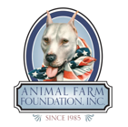
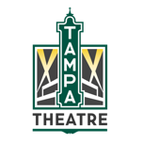
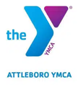
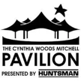
Trusted by 1,500+ nonprofits and growing
Logos
Notes:
SAY: Here’s “WHO” Feathr works with: 1,200 nonprofits currently use Feathr’s marketing and fundraising tools.
We support large organizations like the United Way and International Justice Mission… to small, local orgs like the Humane Society of North Central Florida.
We can reach broad audiences, like CRS’s mission to advance sustainable energy… down to very niche audiences, like Hope and a Future’s goal to support faith-based Foster care in Arizona.
ASK: Are you familiar with any of the orgs listed on this screen?
TRANSITION: Bottomline, Feathr is not trying to be everything for everyone. We just do digital marketing really well for nonprofits.
Since we have the “WHO” slide, can we put in the “WHAT” Feathr does slide next?

Slide 12
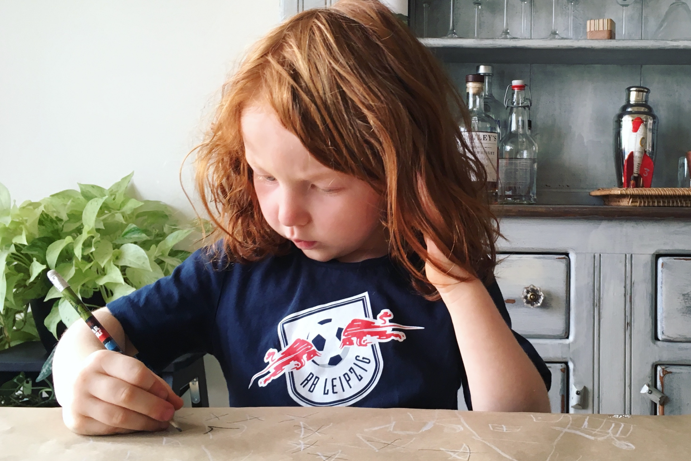

Slide 13
The Good Marketing Framework
Communities
Understand
Identify
Context & Intent
Learn
Good
Cultivate
Known & Unknown
CRM / Email Lists
Website visitors
Prospect lists
Social / communities
Event attendees
Members
Volunteers
Beneficiaries
Patrons
Mission, Advocacy, Community, Connection
Conversions
Activate
Connections
Membership, Donations, Tickets, Signups, Etc.
Email, Social, Mail, Retargeting, Search, Etc.
Notes:
Talk about engagement lifecycles in the context of this framework
Acquisition
Engagement
Cultivation

Slide 14
Engagement funnel
Awareness
Engagement
Conversion
Word of Mouth
Keyword Search
Geofencing
Lookalike Audiences
Events
Retargeting
CRM / Email Mapping
Organic / Paid Social
Direct Mail / Offline
SMS Messages
Retargeting
Intent-Based
Smart Email
Personal Outreach
Notes:
Based on your goals - I’d recommend our online donations flight. It includes 10-15 campaigns that are designed to engage your donors at scale with relevant messaging to maximize funds throughout their year with a specific focus around key appeals. Will start with the low hanging fruit of better engagement and conversion campaigns 1st. Then talk about awareness and audience expansion.

Slide 15
1
Identify
Who?
Context?
Intent?

Slide 16
Awareness
Engagement
Cultivation
Image by rawpixel.com on Freepik
Retargeting
Search Keyword
Single Send
Facebook Retargeting
Lookalike
Auto Send
Email Mapping
Mobile Geofencing
Smart Send
Facebook Email Mapping
Historical Geofencing
Peer-to-Peer

Slide 17
R E M I N D E R
What you know about your community drives campaigns

Slide 18
Agenda
Example Segments / IDs
Active supporters
Members
Website visitors (known + unknown)
Event attendees
Target beneficiaries (based on prior engagement or target locations)
Volunteers
Patrons / visitors
Lapsed supporters / participants

Slide 19
R E M I N D E R
Relevancy over reach

Slide 20
The Good Marketing Framework
Communities
Understand
Identify
Context & Intent
Learn
Good
Cultivate
Known & Unknown
CRM / Email Lists
Website visitors
Prospect lists
Social / communities
Event attendees
Members
Volunteers
Beneficiaries
Patrons
Mission, Advocacy, Community, Connection
Conversions
Activate
Connections
Membership, Donations, Tickets, Signups, Etc.
Email, Social, Mail, Retargeting, Search, Etc.
Notes:
Talk about engagement lifecycles in the context of this framework
Acquisition
Engagement
Cultivation

Slide 21
Cultivate
Content
Channels
2

Slide 22
Marketing funnel
Awareness
Engagement
Conversion
Word of Mouth
Keyword Search
Geofencing
Lookalike Audiences
Events
Retargeting
CRM / Email Mapping
Organic / Paid Social
Direct Mail / Offline
SMS Messages
Retargeting
Intent-Based
Smart Email
Personal Outreach
Notes:
Based on your goals - I’d recommend our online donations flight. It includes 10-15 campaigns that are designed to engage your donors at scale with relevant messaging to maximize funds throughout their year with a specific focus around key appeals. Will start with the low hanging fruit of better engagement and conversion campaigns 1st. Then talk about awareness and audience expansion.

Slide 23
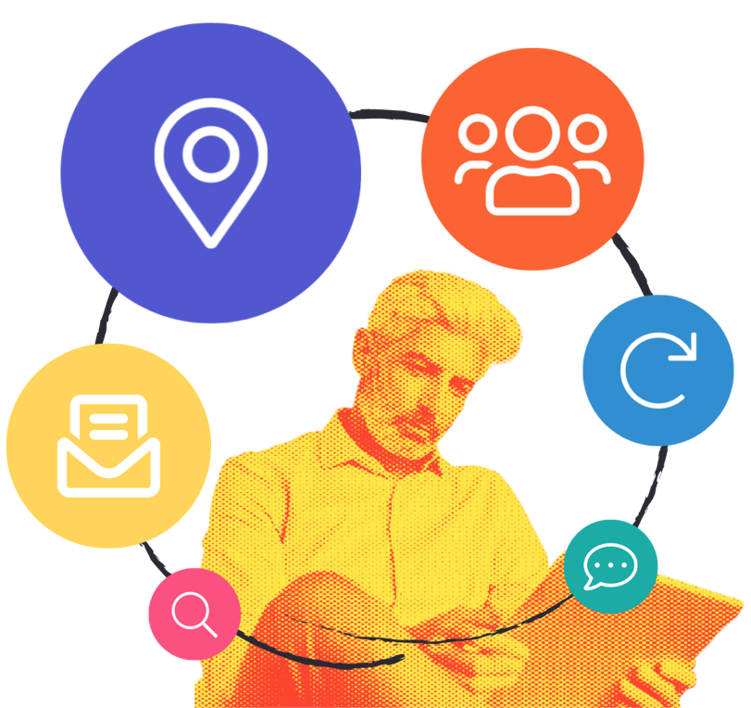
Omnichannel Campaigns
Reach people at every stage of engagement, and simplify reporting with all channels in one place
Email
Display Ads
Social Ads
Website Engagement
Marketing Automation
Landing Pages

Slide 24
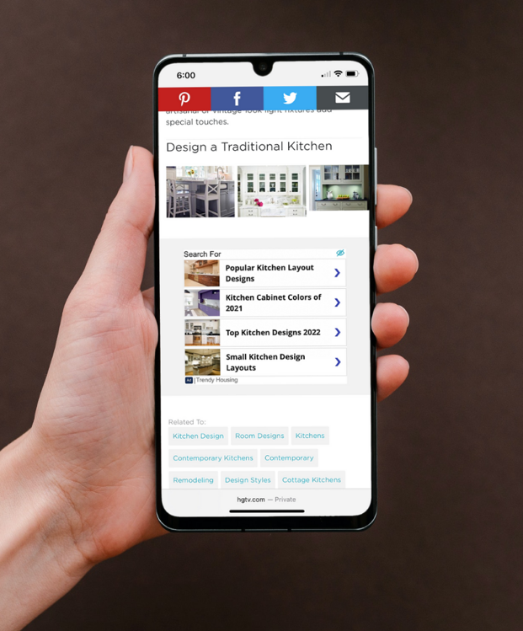
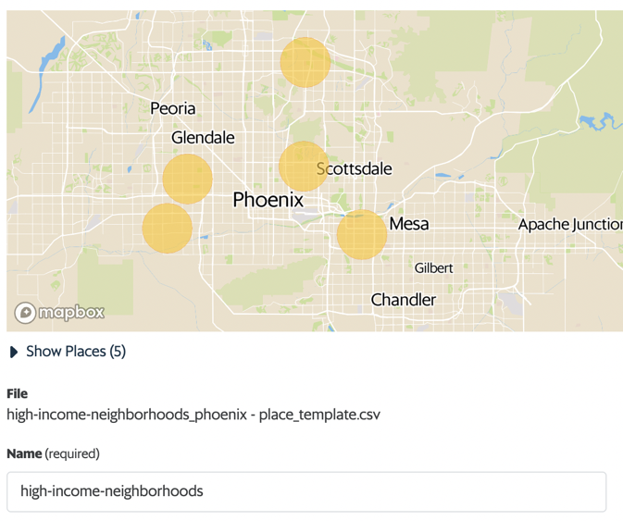
Donation Geofencing
Awareness Geofencing
Target people in specific locations.
Notes:
SAY: So far we have talked about engaging your current audience better, This next campaign is focused on getting your message in front of brand new people!
Geofencing is like dropping a pin on a map, drawing a circle around that pin… and serving messages to everyone inside that circle. This example shows how “Hope and a Future” geofenced high-income neighborhoods in Arizona to reach potential donors.
((Use tie backs here to show how geofencing helps with their goal))
ASK: Is there a specific area where you’d like to connect with people who would likely support your mission?
((Examples to get the ideas flowing…
Donors: high income neighborhoods, golf courses, galas, theaters, other nonprofit fundraisers
Younger audiences: colleges, music festivals, restaurants, shopping districts
Supporters/advocacy: government offices, state capitals))

Slide 25
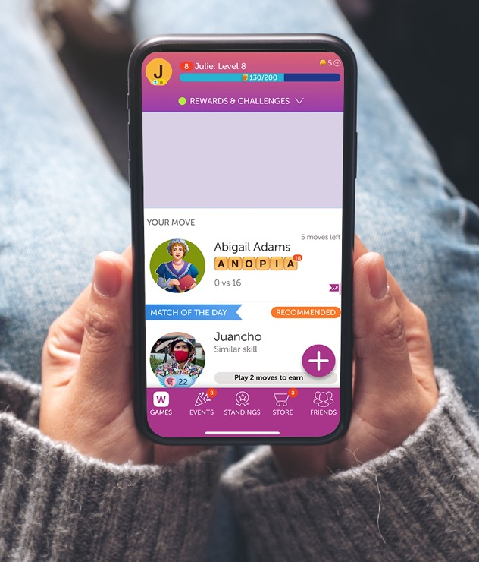
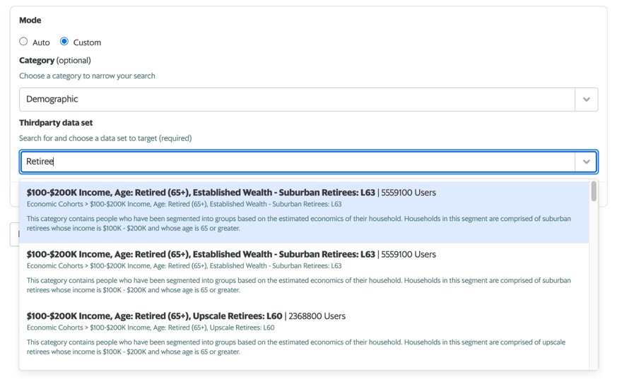
Donation Lookalike
Awareness Affinity Targeting
Build an audience from scratch that matches characteristics of your existing donors: income demographics, purchase history, industry affiliation, location, and more.
Notes:
SAY: Affinity campaigns require nothing upfront to execute, and there are literally more than 7,000 categories to choose from. With a few clicks, you can build an ad campaign targeting thousands of new, RELEVANT people.
Feathr pulls affinity data from multiple reliable sources and updates regularly each month to provide access to the most relevant audiences.
ASK: What are some of the characteristics of people who would support your mission?

Slide 26
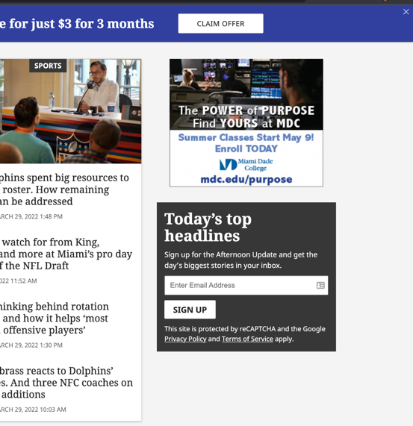
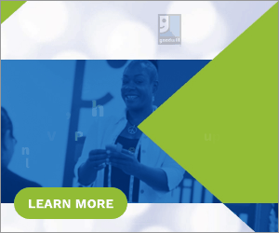
Donation Search
Awareness Keyword Search
Serve dynamic messages to people searching for your services or related topics.
Notes:
SAY: Another awareness campaign is called “Search Keyword” - where we serve ads to people who are searching for your services or related topics.
This example shows someone searching for a way to arrange a furniture donation pickup. As they browse the internet later on… Feathr’s client, Goodwill, is able to serve them ads speaking DIRECTLY to their interest in donating.
((Use tie backs here to show how search keyword helps with their goal)) ASK: Do you have any competitor or complimentary orgs whose supporters may be interested in your mission?

Slide 27
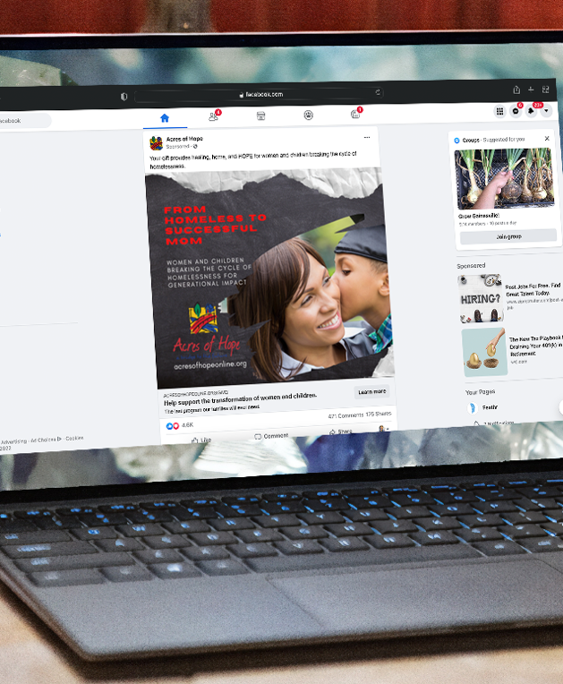
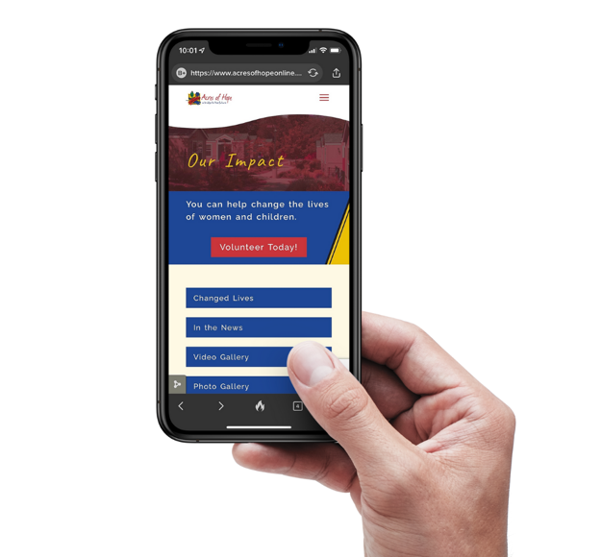
Program Awareness FB Retargeting
Remind your audience about your program(s) while they scroll through Facebook and Instagram.
Engagement Facebook Retargeting

Slide 28
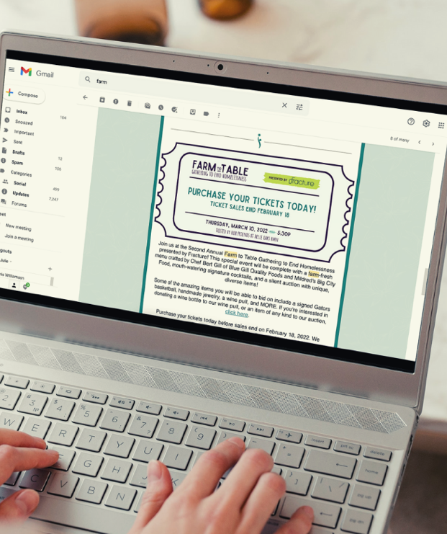
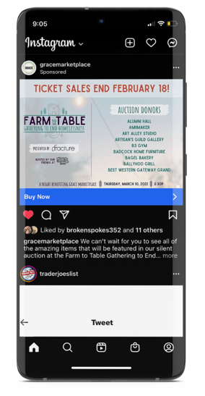
Events Smart Send
Send emails triggered by someone’s interaction with your website or ads — and see how many register for your event.
Engagement Smart Send Email
Notes:
SAY: Display ads and email automation are the best 1-2 punch in nonprofit digital marketing.
Feathr includes an email feature that TALKS to your ad strategy. We can automatically send emails to people who visit a certain part of your website or who click on your ads. This means sending the right message at the exact moment someone engages with you.
Feathr’s email tool includes unlimited sends and contacts… plus the ability to track conversions, like actual ticket sales, not JUST email opens and click throughs.
ASK: Who do use for email? Are you happy with them? What’s the ballpark cost per year?

Slide 29
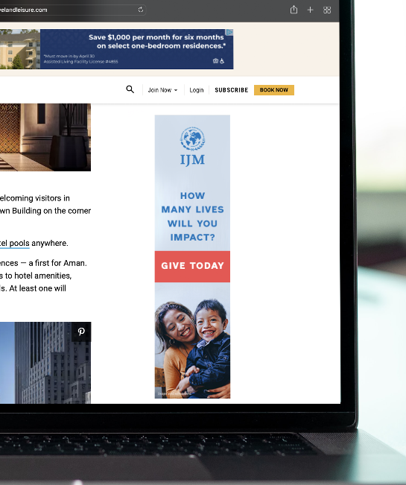
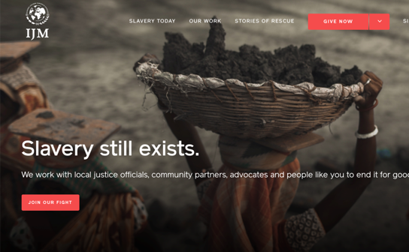
Donation Retargeting
Serve targeted ads to people who visit specific pages on your website.
Engagement Retargeting
Notes:
SAY: Here’s what that looks like for nonprofits.
IJM has thousands of people who visit their website every month… but leave before taking any action or providing any contact information.
With Feathr, they’re able to track the behaviors of those anonymous web visitors… and then serve them reminder messages all over the internet in the days and weeks to come. We know it take 10-15 touches to get someone to take action. Retargeting is powerful and cost effective method for delivering those touches.
((Use tie backs here to show how retargeting helps with their goal)) ASK: How do you all follow-up with your website visitors now? Any questions on how it works or how it would work for you?

Slide 30
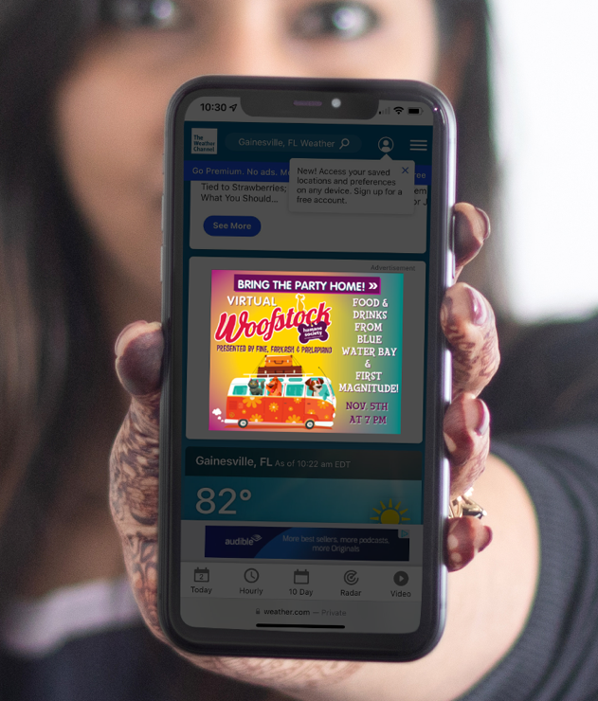
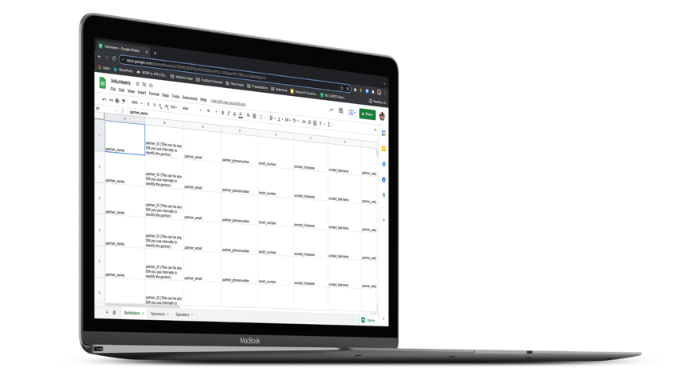
Donation FB Email Mapping
Serve online ads to 60-80% of people not opening your emails. Donors, prospects, volunteers, members, etc.
Engagement Email Mapping
Notes:
ASK: For your email outreach… what’s the average open rate for something like a Monthly Newsletter?
SAY: The average open rate for nonprofits is around 20%. That means 80% of the audience isn’t getting the message. That doesn’t necessarily mean they don’t care about you… it likely means they just get too many emails.
Email mapping allows you to reach people from your email list OUTSIDE of their inbox… by serving them ads.
((Use tie backs here to show how email mapping helps with their goal))
ASK: How many email addresses are stored in your database?
((2,500 emails is the threshold for successful email mapping.))
If they have LESS than 2,500… 500 for facebook email mapping
SAY: We’ll need a slightly larger email list to make this work for you. We can help with that by serving ads which send people directly to your email newsletter sign-up page.

Slide 31
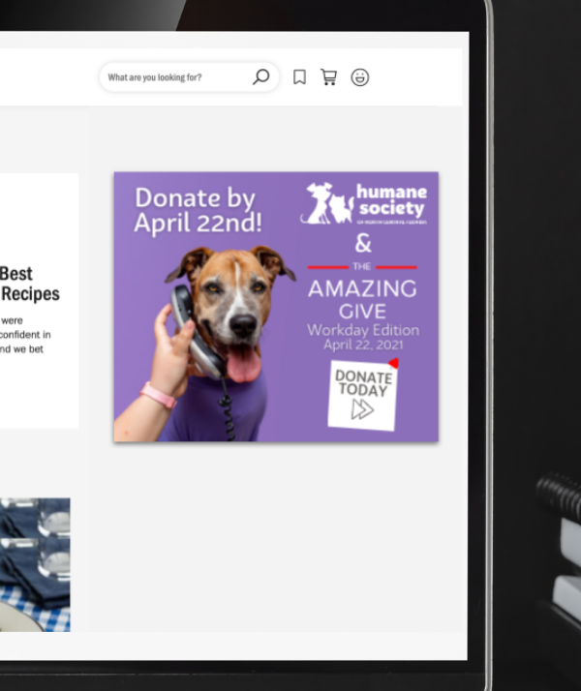
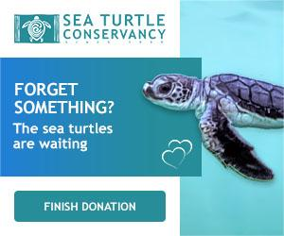
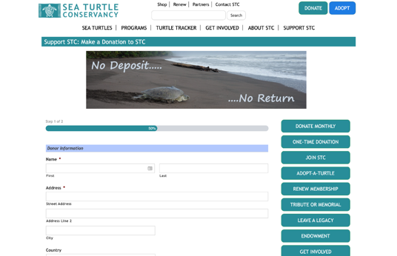
Donation Abandonment
Conversion Donation Abandonment
Target people who started to fill out your form,
but didn’t finish.
Notes:
SAY: The number one suggestion Feathr has for nonprofits to maximize their digital marketing success is Form Abandonment campaigns. In this example, the Sea Turtle conservancy served a reminder to everyone who started filling out a donation form, but didn’t finish it. The turtle is reminding them to finish their donation!
((Use tie backs here to show how form abandonment helps with their goal))
ASK: Are you using any methods to track the form abandoners on your site currently? If so - how are you reaching back out to them to nudge them to finish?

Slide 32
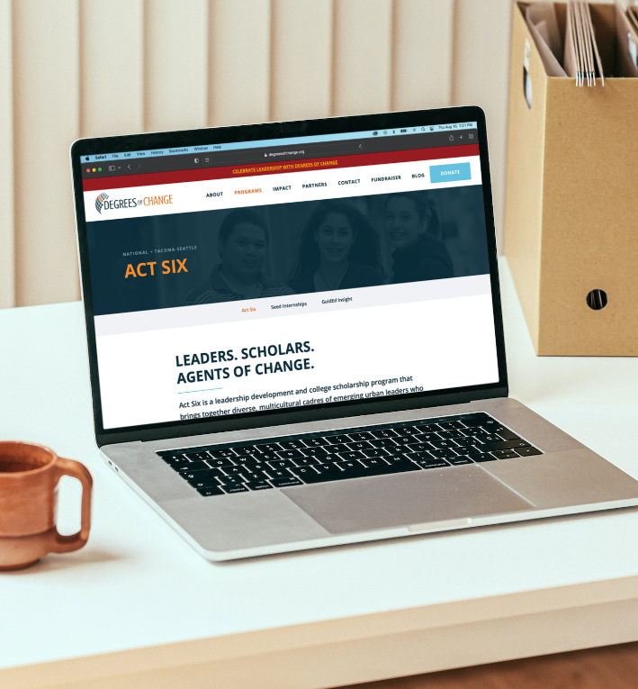
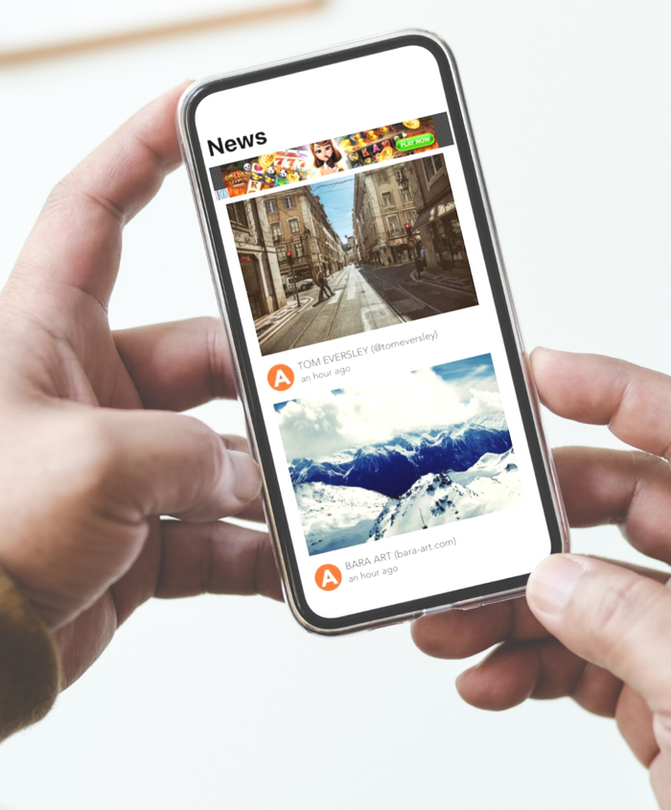
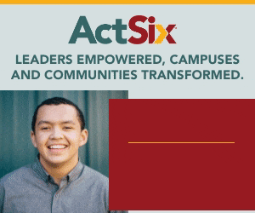
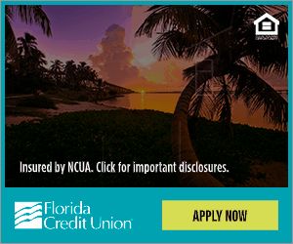

Slide 34
R E M I N D E R
Community-first, not channel-based reporting

Slide 35
Awareness
Engagement
Cultivation
Image by rawpixel.com on Freepik
Retargeting
Search Keyword
Single Send
Facebook Retargeting
Lookalike
Auto Send
Email Mapping
Mobile Geofencing
Smart Send
Facebook Email Mapping
Historical Geofencing
Peer-to-Peer

Slide 36
The Good Marketing Framework
Communities
Understand
Identify
Context & Intent
Learn
Good
Cultivate
Known & Unknown
CRM / Email Lists
Website visitors
Prospect lists
Social / communities
Event attendees
Members
Volunteers
Beneficiaries
Patrons
Mission, Advocacy, Community, Connection
Conversions
Activate
Connections
Membership, Donations, Tickets, Signups, Etc.
Email, Social, Mail, Retargeting, Search, Etc.
Notes:
Talk about engagement lifecycles in the context of this framework
Acquisition
Engagement
Cultivation

Slide 37
3
Activate
Measurement
Testing Framework

Slide 38
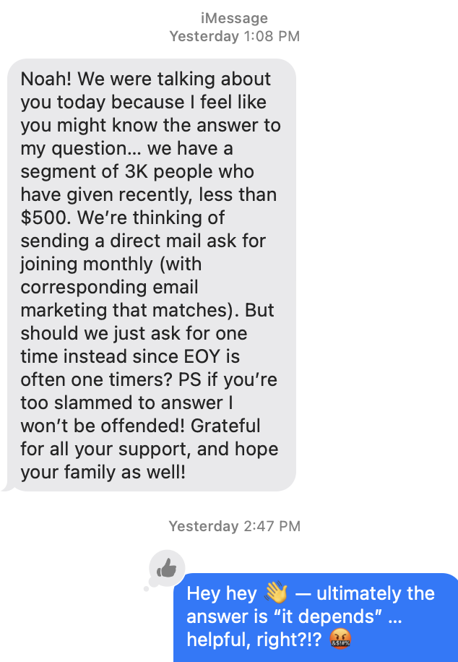
“It depends …”

Slide 39
E X A M P L E
Three (3) Types of Tests
Trying
***
Testing new things (lack controls) to learn and benchmark results for future pilots or experiments.
Pilot
***
Organized tests of new things with clear hypothesis on expected results within a predetermined time frame.
Experiments
***
Variable testing that includes a hold out or control group to determine if a specific test performs better.

Slide 40
R E M I N D E R
Assume you’re wrong. Your goal is to find out how wrong as quickly as possible

Slide 41
The Good Marketing Framework
Communities
Understand
Identify
Context & Intent
Learn
Good
Cultivate
Known & Unknown
CRM / Email Lists
Website visitors
Prospect lists
Social / communities
Event attendees
Members
Volunteers
Beneficiaries
Patrons
Mission, Advocacy, Community, Connection
Conversions
Activate
Connections
Membership, Donations, Tickets, Signups, Etc.
Email, Social, Mail, Retargeting, Search, Etc.
Notes:
Talk about engagement lifecycles in the context of this framework
Acquisition
Engagement
Cultivation

Slide 42
Learn
New context & intent
Learning log
4

Slide 43
Growth is a result of …
PROGRAMS reach, results, revenue
What’s working? Why?
What’s not? Why?
Impact vs. time-to-value
PROCESS
collaboration, cadence
Where are bottlenecks?
Manage work async?
Accountability rhythms
Tooling / SOPs needed?
PEOPLE fit, focus, future
Abilities? Best work?
Align OKRs, remove distractions
Develop growth plans

Slide 44
E X A M P L E
Responsive Rhythms
Weekly
***
Monday Metrics
Priority Huddles
Weekly Wrap
Monthly
***
Retrospectives
Priority Check-in
Quarterly
***
PPP Review
Audience Feedback
POT Refactor

Slide 45
The Good Marketing Framework
Communities
Understand
Identify
Context & Intent
Learn
Good
Cultivate
Known & Unknown
CRM / Email Lists
Website visitors
Prospect lists
Social / communities
Event attendees
Members
Volunteers
Beneficiaries
Patrons
Mission, Advocacy, Community, Connection
Conversions
Activate
Connections
Membership, Donations, Tickets, Signups, Etc.
Email, Social, Mail, Retargeting, Search, Etc.
Notes:
Talk about engagement lifecycles in the context of this framework
Acquisition
Engagement
Cultivation

Slide 46
B O N U S
Cultivation Campaign Examples

Slide 47
1
Retarget segments based on prior context and intent

Slide 48
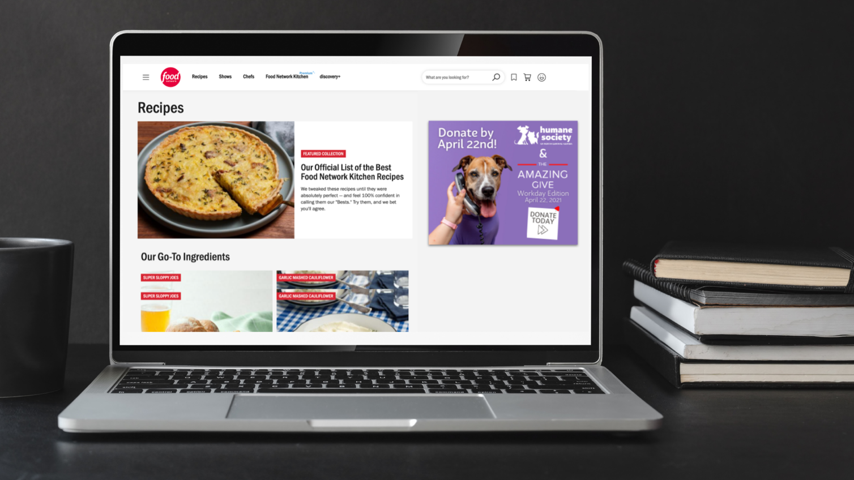
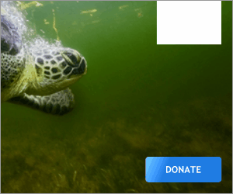

Slide 49
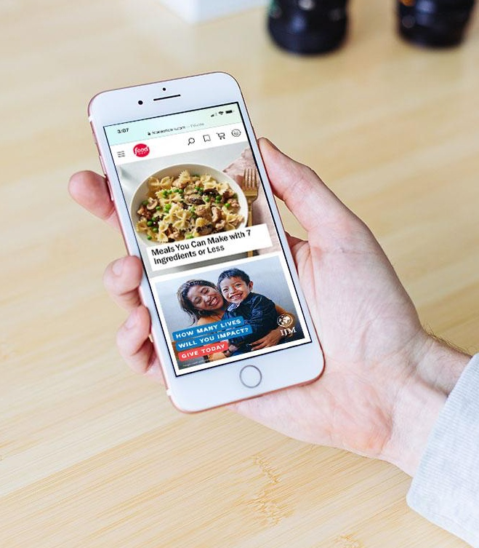
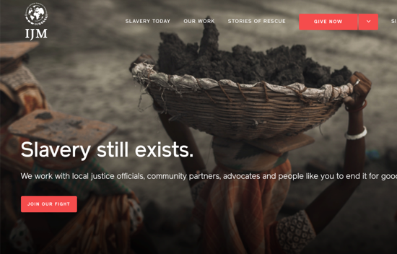
Notes:
Serve super-targeted ads to different segments based on page views, browsing behavior, email lists, etc. whenever and wherever they are online. .

Slide 50
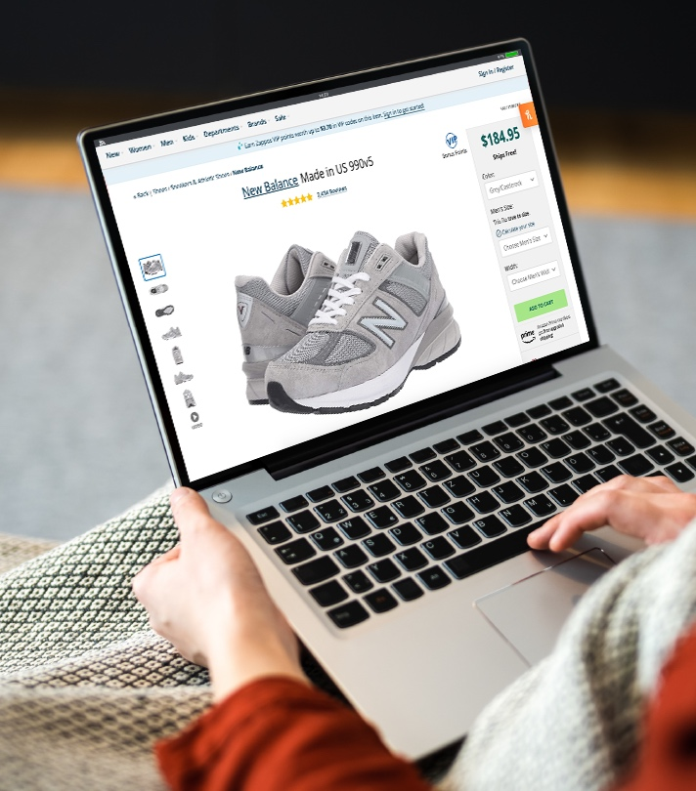
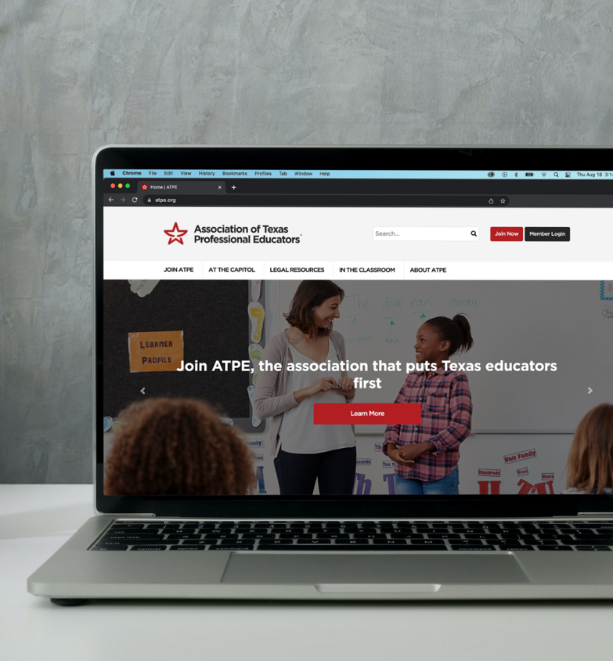
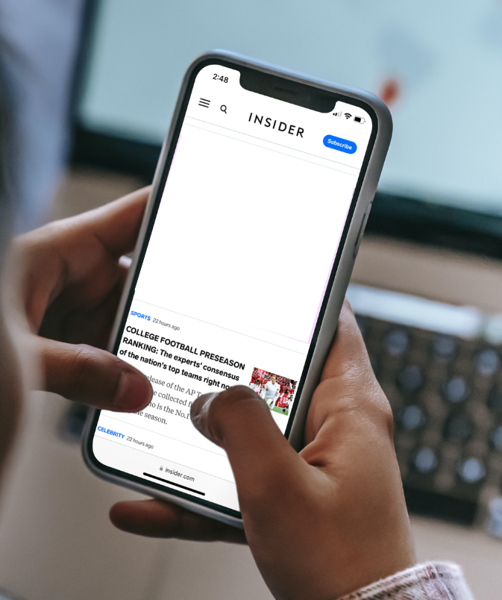

Slide 51
2
Reactivate donor segments within your CRM

Slide 52
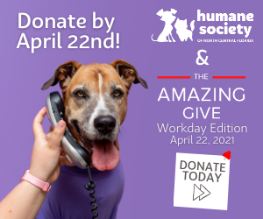
E X A M P L E Supercharge your local giving day
Email lists targeted:
Recent & previous donors
Former volunteers
Previous event attendees
List of unsubscribers!
Notes:
Reach the ~80% of people who don’t open emails

Slide 53
Reach audiences based on where your community lives, work, & play
3

Slide 54
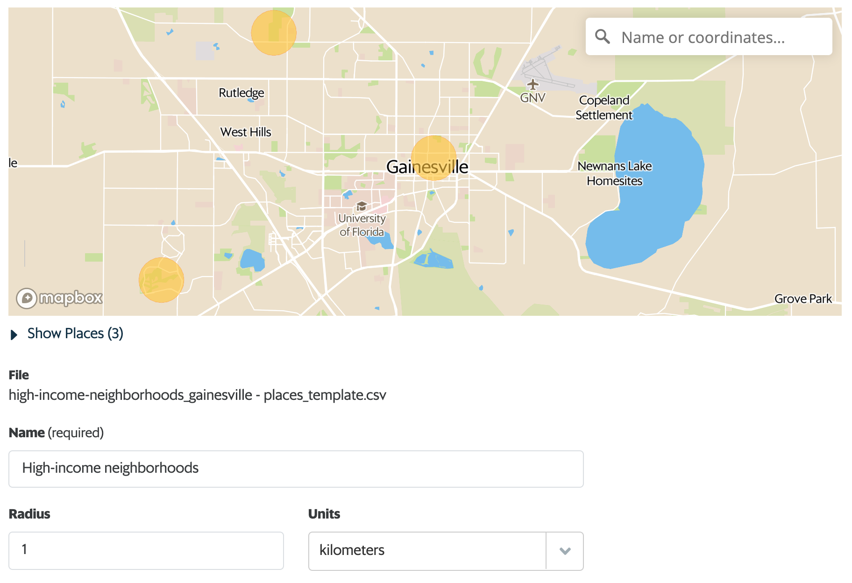

Slide 55
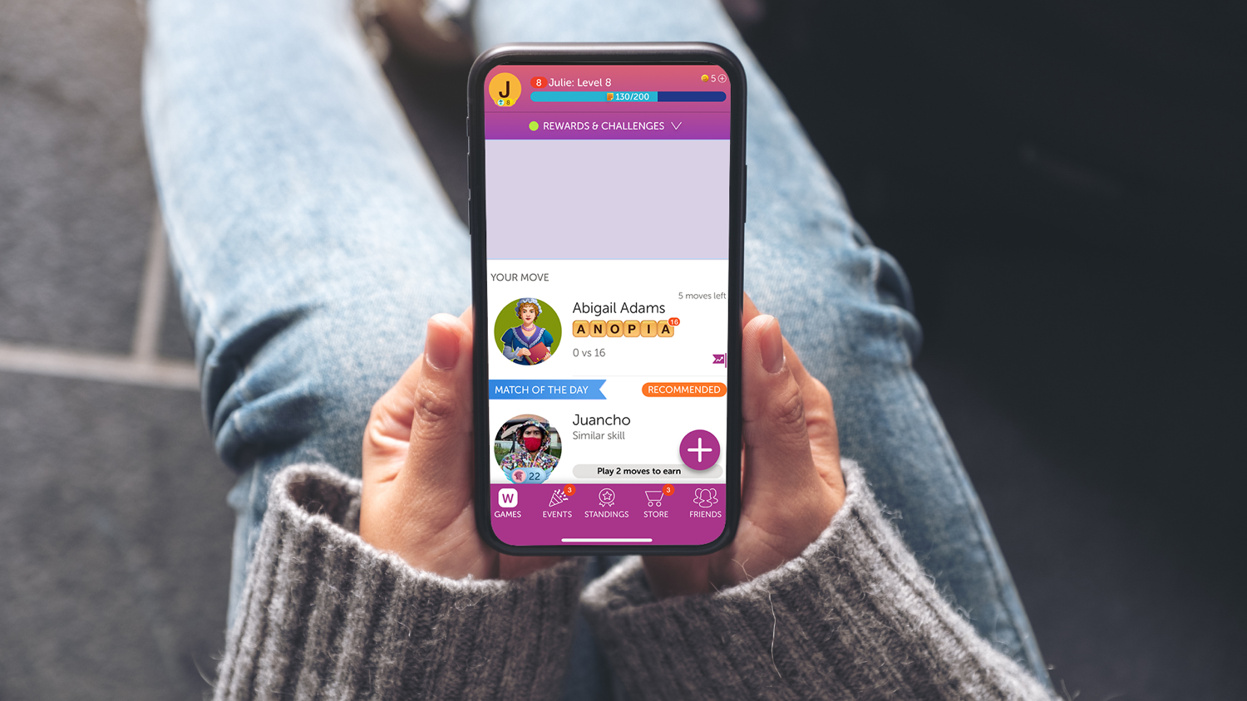
Equality Florida Ad Example
Notes:
virtual event

Slide 56
D I S C U S S I O N
Discussion: Applying the Good Marketing Framework

Slide 57
The Good Marketing Framework
Communities
Understand
Identify
Context & Intent
Learn
Good
Cultivate
Known & Unknown
CRM / Email Lists
Website visitors
Prospect lists
Social / communities
Event attendees
Members
Volunteers
Beneficiaries
Patrons
Mission, Advocacy, Community, Connection
Conversions
Activate
Connections
Membership, Donations, Tickets, Signups, Etc.
Email, Social, Mail, Retargeting, Search, Etc.
Notes:
Talk about engagement lifecycles in the context of this framework
Acquisition
Engagement
Cultivation

Slide 58
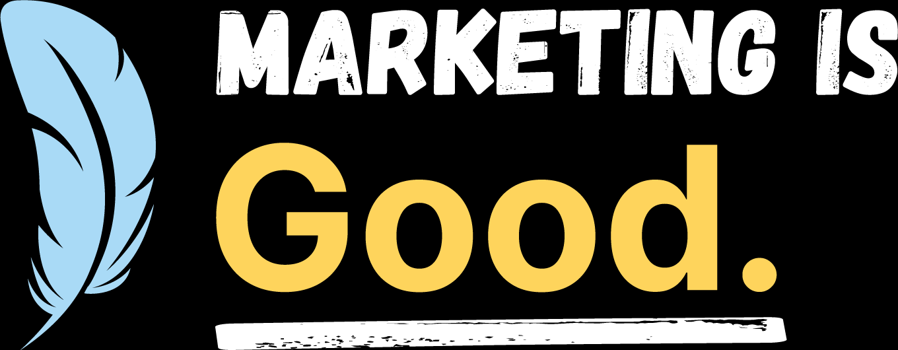

Slide 59
Any questions?

Slide 60
R E M I N D E R
Take chances, make mistakes,
get messy!

Slide 61
A D S | E M A I L | A N A L Y T I C S
Feathr helps your nonprofit run and report on integrated marketing campaigns that grow your community and unlock more impact.
Stop by the Feathr booth to see how!
Notes:
SAY: Feathr is the good marketing platform purpose-built to help you you know, grow, and engage your audiences across multiple channels with ease. We’re here to be your partner as you do good marketing to do more Good.

